Slide 1
CSI2005 Principles of Compiler Design
MODULE – 2
Dr. WI. Sureshkumar
Associate Professor
School of Computer Science and Engineering (SCOPE)
VIT Vellore
wi.sureshkumar@vit.ac.in
SJT413A34

Slide 2
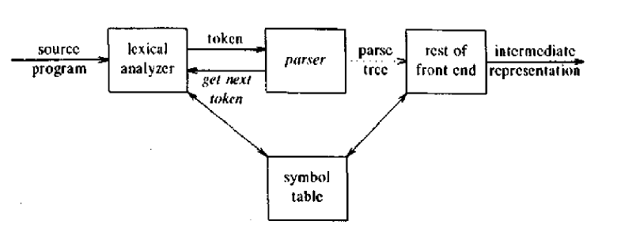

Slide 3
Top-Down Parsing
The parse tree is created top to bottom.
Top-down parser
Recursive-Descent Parsing
Backtracking is needed (If a choice of a production rule does not work, we backtrack to try other alternatives.)
It is a general parsing technique, but not widely used.
Not efficient
Predictive Parsing
no backtracking
needs a special form of grammars (LL(1) grammars).
Non-Recursive (Table Driven) Predictive Parser is also known as LL(1) parser.

Slide 4
Recursive-Descent Parsing (uses Backtracking)
Backtracking is needed.
It tries to find the left-most derivation.
S → cAd
A → ab| a
S S
input: cad
c A d c A d
a b a

Slide 5
Recursive Descent Parser
Now, we have a match for the second input symbol “a”, so we advance the input pointer to “d”, the third input symbol, and compare d against the next leaf “b”.
Backtracking
Since “b” does not match “d”, we report failure and go back to A to see whether there is another alternative for A that has not been tried - that might produce a match
In going back to A, we must reset the input pointer to “a”.

Slide 6
Creating a top-down parser
Top-down parsing can be viewed as the problem of constructing a parse tree for the input string, starting form the root and creating the nodes of the parse tree in preorder.

Slide 7
Example
Given the grammar :
E → TE’
E’ → +TE’ | ε
T → FT’
T’ → *FT’ | ε
F → (E) | id
The input: id + id * id

Slide 8
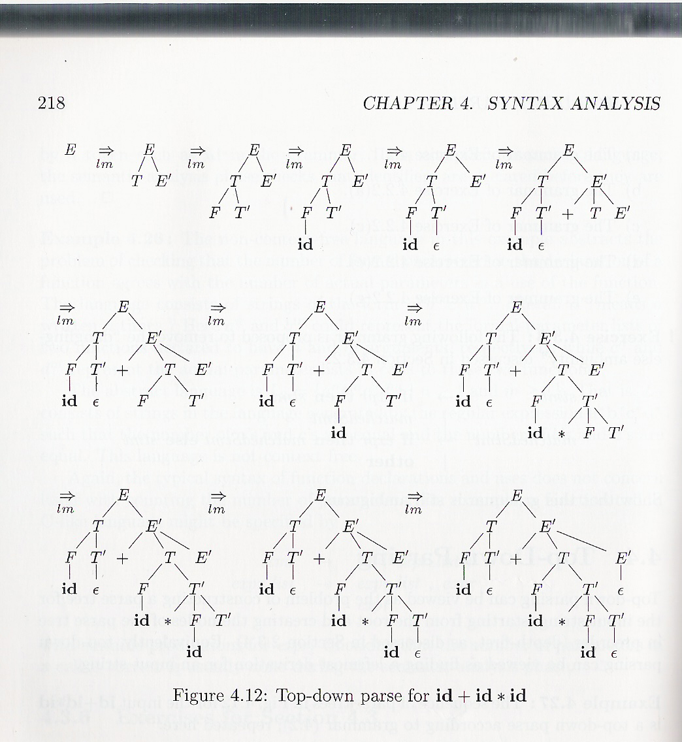

Slide 9
Predictive parsers
The class of grammars for which we can construct predictive parsers looking k symbols ahead in the input is called the LL(k) class.
recursive-descent parsers without backtracking
The first “L” stands for scanning input from left to right.
The second “L” for producing a leftmost derivation.
The “1” for using one input symbol of look-ahead at each step to make parsing decisions.

Slide 10
LL(1) Grammars
A grammar whose parsing table has no multiply-defined entries is said to be LL(1) grammar.
One input symbol used as a look-head symbol to determine parser action
LL(1) left most derivation
Input scanned from left to right
The parsing table of a grammar may contain more than one production rule. In this case, we say that it is not a LL(1) grammar.

Slide 11
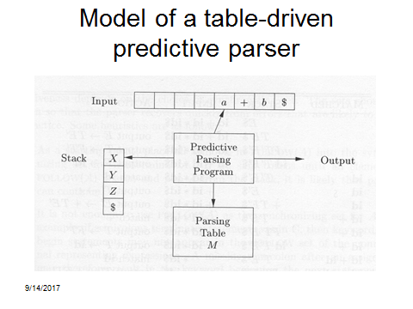

Slide 12
Constructing LL(1) Parsing Tables
Two functions are used in the construction of LL(1) parsing tables:
FIRST
FOLLOW

Slide 13
Compute FIRST
To compute FIRST(X) for all grammar symbols X, apply the following rules until no more terminals or ε can be added to any FIRST set.
If X is terminal, then FIRST(X) = { X }.
If X → ε is a production, then add ε to FIRST(X).
If X is non-terminal and X →Y₁Y₂. . . Y_{K} is a production, then place a in FIRST(X) if for some i, a is in FIRST(Y_{i}) and ε is in all of FIRST(Y₁), FIRST(Y₂), . . ., FIRST(Y_{i-1}). If ε is in FIRST(Y_{j}) for all j=1, 2, . . . , k, then add ε to FIRST(X).

Slide 14
Compute FOLLOW
To compute FOLLOW(A) for all non-terminals A, apply the following rules until nothing can be added to any FOLLOW set.
Place $ FOLLOW(S), where S is the start symbol and $ is the input right end marker.
If there is a production A → αBβ, then everything in FIRST(β) except for ε is placed in FOLLOW(B).
If there is a production A → αB, or a production A → αBβ where FIRST(β) contains ε , then everything in FOLLOW(A) is in FOLLOW(B).
If A can be the rightmost symbol in some sentential form, then $ is in FOLLOW(A).

Slide 15
Example - 1
E → E + T / T
T → T * F / F
F → ( E ) / id
Eliminate the immediate left recursion,
E → TE’
E’ → +TE’ / ε
T → FT’
T’ → *FT’ / ε
F → ( E ) / id

Slide 16
Example - 1
FIRST(F) = {(,id}
FIRST(T’) = {*, ε}
FIRST(E’) = {+, ε}
FIRST(T) = {(,id}
FIRST(E) = {(,id}
FOLLOW(E) = { $, ) } F → (E) | id
FOLLOW(E’) = { $, ) } E → TE’ FOLLOW(E)
FOLLOW(T) = { +, ), $ } FIRST(E’) = {+, ε} FOLLOW(E) = { $, ) }
FOLLOW(T’) = { +, ), $ } FOLLOW(T)
FOLLOW(F) = { *,+, ), $ } FIRST(T’) FOLLOW(T)

Slide 17
Construction of a Predictive Parsing Table
Input : Grammar G
Output : Parsing table M.
Method:
For each production A → α of the grammar, do step 2 and 3.
For each terminal a in FIRST(α), add A → α to M[A, a].
If ε is in FIRST(α), add A → α to M[A, b] for each terminal b in FOLLOW(A). If ε is in FIRST(α) and $ is in FOLLOW(A), add
A → α to M[A, $]
4. Mark each undefined entry of M be error.

Slide 18
LL(1) Parsing Table
 | id | + | * | ( | ) | $
E | E → TE’ |  |  | E → TE’
E’ |  | E’ → +TE’ |  |  | E’ → ε | E’ → ε
T | T → FT’ |  |  | T → FT’
T’ |  | T’ → ε | T’ → *FT’ |  | T’ → ε | T’ → ε
F | F → id |  |  | F → (E)

Slide 19
Non recursive predictive parsing
The parser considers X, the symbol on top of the stack, and a, the current input symbol. These two symbols determine the action of the parser. There are three possibilities.
If X = a = $, the parser halts and announces successful completion of parsing.
If X = a ≠ $, the parser pops X off the stack and advances the input pointer to the next input symbol.
If X is a non-terminal, the parser consults entry M[X, a] of the parsing table M. This entry will be either an X- production or an error entry. If, for example, M[X, a] = {X →UVW}, the parse replaces X on the top of the stack by WVU (with U on top). As output, we shall assume that the parser just prints the production used.
If M[X, a] = error, the parser calls an error recovery routine.

Slide 20
LL(1) Parser
Stack | Input | Output
$E | id + id * id $
$E’T | id + id * id $ | E → TE’
$E’T’F | id + id * id $ | T → FT’
$E’T’id | id + id * id $ | F → id
$E’T’ | + id * id $ | match id
$E’ | + id * id $ | T’ → λ
$E’T+ | + id * id $ | E’ → +TE’

Slide 21
LL(1) Parser
Stack | Input | Output
$E’T | id * id $ | match +
$E’T’F | id * id $ | T → FT’
$E’T’id | id * id $ | F → id
$E’T’ | * id $ | match id
$E’T’F* | * id $ | T’ → *FT’
$E’T’F | id $ | match *
$E’T’id | id $ | F → id
$E’T’ | $ | match id
$E’ | $ | T’ → λ
$ | $ | E’ → λ

Slide 22
E
T
E’
F
T’
+
T
E’
id
ε
ε
F
T’
id
*
F
T’
id
ε

Slide 23
Example - 2
Consider the grammar
S → (L) / a
L → L , S / S
Construct a predictive parser for the above grammar. Also, find the parse trees for the following words:
i) (a, a)
ii) (a, (a, a))
iii) (a, ((a, a), (a, a)))

Slide 24
Eliminate the immediate left recursion,
S → (L) / a
L → SL’
L’ → ,SL’ / ε
FIRST(S) = {(, a}
FIRST(L) = {(, a}
FIRST(L’) = {,, ε}
FOLLOW(S) = { $, , , )}
FOLLOW(L) = { ) }
FOLLOW(L’) = { ), $ }

Slide 25
LL(1) Parsing Table
 | ( | ) | a | , | $
S | S → (L) |  | S → a
L | L → SL’ |  | L → SL’
L’ |  | L’ → ε |  | L’ → ,SL’ | L’ → ε

Slide 26
Stack | Input | Output
$ S | (a, a)$ | S → (L)
$ ) L ( | (a, a)$ | match (
$) L | a, a) $ | L → SL’
$) L’ S | a, a) $ | S → a
$) L’ a | a, a) $ | match a
$) L’ | , a) $ | L’ → ,SL’
$) L’ S , | , a) $ | match ,
$) L’ S | a) $ | S → a
$) L’ a | a) $ | match a
$ ) L’ | ) $ | L’ → ε

Slide 27
Stack | Input | Output
$ | $ | Halt

Slide 28
S
(
L
)
S
L’
a
,
s
L’
a
ε

Slide 29
Example - 3
S → iEtS / iEtSeS / a
E → b
Using left factoring the original productions becomes,
S → iEtSS₁ / a
S₁→ eS / ε
E → b
FIRST(S) = {i, a} FOLLOW(S) = { e, $ }
FIRST(S₁) = {e, ε} FOLLOW(S₁) = { e, $}
FIRST(E) = { b} FOLLOW(E) = { t }

Slide 30
Hence the given grammar not LL(1).
i | a | b | e | t | $
S → iEtSS₁ | S → a
 |  |  | S₁→ eS S₁→ ε |  | S₁→ ε
 |  | E → b
S
S₁
E
(S₁ , a) = {S₁→ eS , S₁→ ε }

Slide 31
Bottom-up Parsing
Bottom up parsing attempts to construct a parse tree for an input beginning at the leaves and working up towards root.
Reducing a string w to S, the start symbol of the grammar.
At each step, a particular substring matching the right side of a production is replaced by the symbol on the left of that production.
A rightmost derivation is traced out in reverse.

